Slide 1
Security in Computing, Fifth Edition
Chapter 9: Privacy

Slide 2
Chapter 9 Objectives
Define privacy and fundamental computer-related privacy challenges
Privacy principles and laws
Privacy precautions for web surfing
Spyware
Email privacy
Privacy concerns in emerging technologies

Slide 3
What Is Privacy?
Privacy is the right to control who knows certain aspects about you, your communications, and your activities
Types of data many people consider private:
Identity
Finances
Health
Biometrics
Privileged communications
Location data
Subject: person or entity being described by the data
Owner: person or entity that holds the data

Slide 4
Computer-Related Privacy Problems
Data collection
Advances in computer storage make it possible to hold and manipulate huge numbers of records, and those advances continue to evolve
Notice and consent
Notice of collection and consent to allow collection of data are foundations of privacy, but with modern data collection, it is often impossible to know what is being collected
Control and ownership of data
Once a user consents to provide data, the data is out of that user’s control. It may be held indefinitely or shared with other entities.

Slide 5
Fair Information Practices
Data should be obtained lawfully and fairly
Data should be relevant to their purposes, accurate, complete, and up to date
The purposes for which data will be used should be identified and that data destroyed if no longer necessary for that purpose
Use for purposes other than those specified is authorized only with consent of data subject or by authority of law
Procedures to guard against loss, corruption, destruction, or misuse of data should be established
It should be possible to acquire information about the collection, storage, and use of personal data systems
The data subjects normally have a right to access and challenge data relating to them
A data controller should be designated and accountable for complying with the measures to effect these principles
Notes:
Based on a 1973 study led by Willis Ware.

Slide 6
U.S. Privacy Laws
The 1974 Privacy Act embodies most of the principles above but applies only to data collected by the U.S. government
Other federal privacy laws:
HIPAA (healthcare data)
GLBA (financial data)
COPPA (children’s web access)
FERPA (student records)
State privacy law varies widely

Slide 7
Non-U.S. Privacy Principles
European Privacy Directive (1995)
Applies the Ware Committee’s principles to governments and businesses
Also provides for extra protection for sensitive data, strong limits on data transfer, and independent oversight to ensure compliance
A list of other nations’ privacy laws can be found at http://www.informationshield.com/intprivacylaws.html

Slide 8
中国隐私保护相关法律
1、《宪法》规定，第三十八条 中华人民共和国公民的人格尊严不受侵犯。
2、《民法通则》规定，第一百零一条 公民、法人享有名誉权，公民的人格尊严受法律保护，禁止用侮辱、诽谤等方式损害公民、法人的名誉。【人格权就包括隐私权】
3、《治安管理处罚法》第四十二条 有下列行为之一的，处五日以下拘留或者五百元以下罚款；情节较重的，处五日以上十日以下拘留，可以并处五百元以下罚款：（二）公然侮辱他人或者捏造事实诽谤他人的；（六）偷窥、偷拍、窃听、散布他人隐私的。
4、《侵权责任法》规定， 第二条 侵害民事权益，应当依照本法承担侵权责任。本法所称民事权益，包括生命权、健康权、姓名权、名誉权、荣誉权、肖像权、隐私权、婚姻自主权、监护权、所有权、用益物权、担保物权、著作权、专利权、商标专用权、发现权、股权、继承权等人身、财产权益。
5、《民事诉讼法》规定
第一百三十四条 人民法院审理民事案件，除涉及国家秘密、个人隐私或者法律另有规定的以外，应当公开进行。
第一百五十六条 公众可以查阅发生法律效力的判决书、裁定书，但涉及国家秘密、商业秘密和个人隐私的内容除外。
6、《刑事诉讼法》规定， 第五十二条 人民法院、人民检察院和公安机关有权向有关单位和个人收集、调取证据。有关单位和个人应当如实提供证据。......对涉及国家秘密、商业秘密、个人隐私的证据，应当保密。
第一百五十条 采取技术侦查措施，必须严格按照批准的措施种类、适用对象和期限执行。侦查人员对采取技术侦查措施过程中知悉的国家秘密、商业秘密和个人隐私，应当保密；
第一百八十三条人民法院审判第一审案件应当公开进行。但是有关国家秘密或者个人隐私的案件，不公开审理；涉及商业秘密的案件，当事人申请不公开审理的，可以不公开审理。

Slide 9
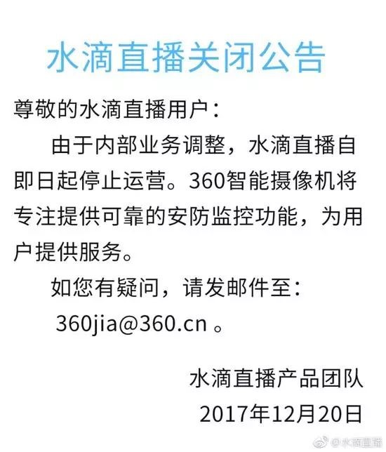
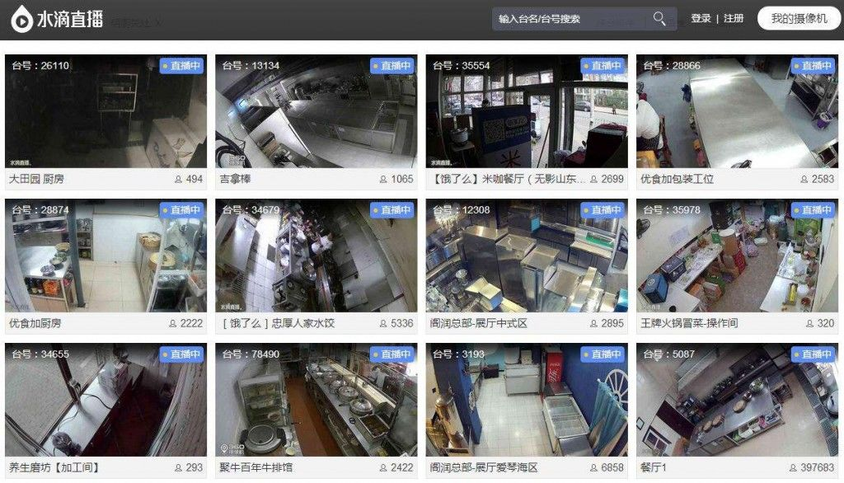
国内个人信息安全事件
2014年3月，国内知名旅游网——携程旅行网被报道，其支付日志存在漏洞，用户银行卡信息可被黑客任意读取。
2017年暗网市场知名供应商双旗（DoubleFlag）抛售从数家中国互联网巨头盗取的大量数据，数据条数达到10亿以上。这些数据来源于网易及其下属公司、腾讯控股、TOM集团、新浪集团、搜狐公司等。

Slide 10
Privacy-Preserving Data Mining
Removing identifying information from data doesn’t work
Even if the overtly identifying information can be removed, identification from remaining data is often possible
Data perturbation
As discussed in Chapter 7, data perturbation can limit the privacy risks associated with the data without impacting analysis results
Data mining often focuses on correlation and aggregation, both of which can generally be reliably accomplished with perturbed data

Slide 11
Precautions for Web Surfing
Cookies
Cookies are a way for websites to store data locally on a user’s machine
They may contain sensitive personal information, such as credit card numbers
Third-party tracking cookies
Some companies specialize in tracking users by having numerous popular sites place their cookies in users’ browsers
This tracking information is used for online profiling, which is generally used for targeted advertising
Web bugs
A web bug is more active than a cookie and has the ability to immediately send information about user behavior to advertising services

Slide 12
Spyware
Spyware is code designed to spy on a user, collecting data
General spyware:
Advertising applications, identity theft
Hijackers:
Hijack existing programs and use them for different purposes, such as reconfiguring file sharing software to share sensitive information
Adware
Displays selected advertisements in pop-up windows or the main browser window
Often installed in a misleading way as part of other software packages

Slide 13
Where Does Email Go?
When Janet sends an email to Scott, the message is transferred via simple mail transfer protocol (SMTP)
The message is the transferred through multiple ISPs and servers before it arrives at Scott’s post office protocol (POP) server
Scott receives the email when his email client logs into the POP server on his behalf
Any of the servers in this chain of communication can see and keep Janet’s email

Slide 14
Anonymous or Disappearing Email
Disposable email addresses from sites like mailinator.com
Remailers are trusted third parties that replace real addresses with pseudonymous ones to protect identities in correspondence
Multiple remailers can be used in a TOR-like configuration to gain stronger anonymity
Disappearing email
Because email travels through so many servers, it cannot be made to truly disappear
Messaging services like Snapchat, which claims to make messages disappear, cannot guarantee that recipients will not be able to save those messages
Notes:
The TOR-like configuration: The sender selects three remailers; he encrypts the message with each of their public keys in succession; he then sends the message through them in the reverse of that order, with each one’s public key being able to open only one layer of message.

Slide 15
Radio Frequency Identification (RFID)
RFID tags are small, low-power wireless radio transmitters
When a tag receives a signal on the correct frequency, it responds with its unique ID number
Privacy concerns:
As RFID tags become cheaper and more ubiquitous, and RFID readers are installed in more places, it may become possible to track individuals wherever they go
As RFID tags are put on more items, it will become increasingly possible to discern personal information by reading those tags

Slide 16
Other Emerging Technologies
Electronic voting
Among other issues, research into electronic voting includes privacy concerns, such as maintaining privacy of who has voted and who each person voted for
Voice over IP (VoIP)
While VoIP adds the possibility of encryption to voice calls, it also allows a new set of service providers to track sources and destinations of those calls
Cloud computing
Physical location of information in the cloud may have significant effects on privacy and confidentiality protections
Cloud data may have more than one legal location at a time
Laws could oblige cloud providers to examine user data for evidence of criminal activity
Legal uncertainties make it difficult to assess the status of cloud data

Slide 17
Summary
What data is considered private is subjective
Privacy laws vary widely by jurisdiction
Cookies and web bugs track user behavior across websites
Spyware can be used to track behavior for targeted advertising or for much more nefarious purposes
Email has little privacy protection by default
Emerging technologies are fraught with privacy uncertainties, including both technological and legal issues

